Slide 1

2023-2024 State Assessment Report
Part II: ACCESS FOR ELLS

Slide 2
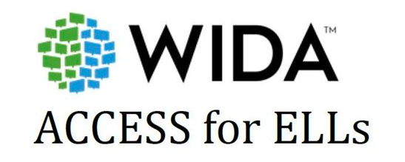
English Language Proficiency Testing for
Multilingual Learners
Spring, 2024

Slide 3
Administered to Kindergarten through 12th-grade students who have been identified as Multilingual Learners
Given annually to monitor students' progress in learning academic English
Meets U.S. federal requirements of the Every Student Succeeds Act (ESSA) for monitoring and reporting Multilingual Learners’ progress toward English language proficiency
Assesses the four language domains of Listening, Speaking, Reading and Writing

Slide 4
SPF ACCESS for ELLs Results 2024
Administered to 97 English Language Learners.
Scored on English Language Proficiency Levels from 1 to 6.
18 students received a score of 4.5 or higher, qualifying them to exit the ESL program.

